Slide 1
Simultaneous localization and mapping on NAO
Taghi Aliyev
Dennis Soemers
Roel Strolenberg
Gabrielle Ras

Slide 2
Outline
Problem Definition
Image Processing
Graph SLAM
EKF SLAM
Experiments
Results
Conclusion & Future Work

Slide 3
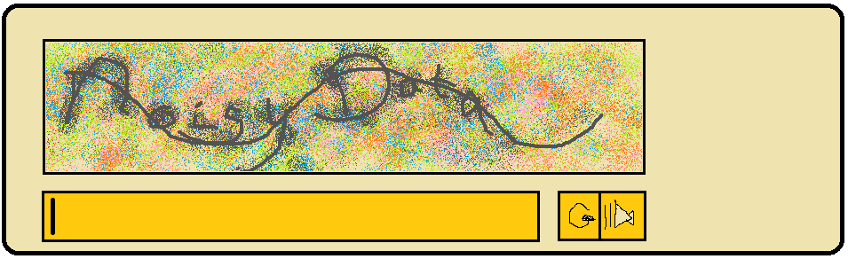
Problem Definition
Real-time simultaneous localization and mapping using the Nao's camera
Landmark detection
Mapping algorithms
Handling noisy data

Slide 4
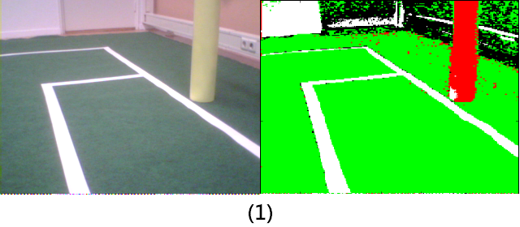
Image Processing
Goal: obtain coordinates of landmarks (goalposts & fieldline cornerpoints)
Prior to new run: take image of grass and goalpost to get interval of the hue of green and yellow
Get average luminence of image
Loop through image and classify pixels as either green, yellow, white or none using the previously calculated bounds for green, yellow and the average luminence (1)

Slide 5
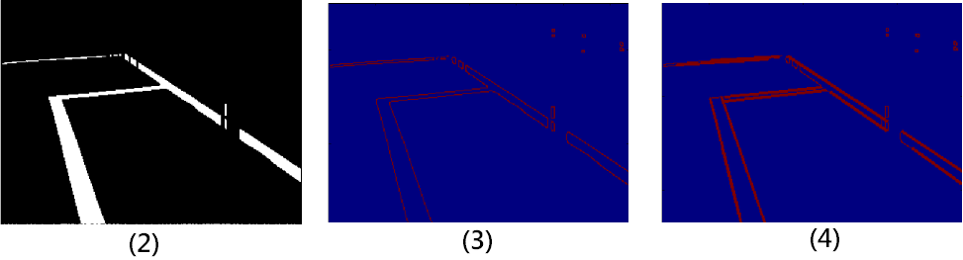
Image Processing (cont.)
Using yellow pixels: extract foot of each goalpost –if any-
Using green pixels: remove background noise (anything outside the field) (2)
OpenCV: edge detection ‘openCV.Canny(...)’ (3)
OpenCV: line detection ‘openCV.HoughLinesP(edges, ...)’ (4)
Loop through lines to find intersections → landmark coordinates
Calculate distance to landmarks

Slide 6
EKF SLAM
Approach to SLAM based on Extended Kalman Filter
Iterative algorithm
Reduce influence of noise by using a series of measurements over time
System state consists of:
  A vector containing estimates of current positions of features
  A matrix containing covariances between features

Slide 7
EKF SLAM – Prediction Step
Predict new state using old state and transition models
Predict new values for covariance using transition models and estimate of noise
  Estimate of noise parameter determined experimentally
Transition Models based on geometric calculations

Slide 8
EKF SLAM – Update Step (1)
Compute Innovation
  Innovation = difference between actual measurement and expected measurement
Compute Kalman Gain
  Matrix of numbers indicating how much we want to gain from the Innovation
  Computed using covariances and estimates of noise
  Tuning noise parameters allows us to trust motion data more than visual measurements...
  ...or other way around

Slide 9
EKF SLAM – Update Step (2)
Update state estimate using Kalman Gain and Innovation
Update covariances using Kalman Gain and Innovation

Slide 10
Graph SLAM
Creates two information matrices: Omega and Xi
Collects three type of constraints:
  Initial position
  Relative motion
  Relative landmark distance

Slide 11
Graph SLAM
Errors are added to Omega and Xi
Best estimates = Omega⁻¹ * Xi

Slide 12
Experiments (1)

Slide 13
Experiments (2)

Slide 14
Results

Slide 15
Conclusions & Future Work

